Slide 1
T-SQL BASICS

Slide 2
Keyed-in order
SELECT
FROM
WHERE
GROUP BY
HAVING
ORDER BY

Slide 3
Logical query processing order
From
Where
Group by
Having
Select
Order by

Slide 4
Result of each phase is a table, which is input into another phase
If order by is specified, the result isn‘t relational

Slide 5
SIMPLE SELECT QUERIES (literal values)
SELECT 1
SELECT 'ABC'

Slide 6
SELECT WITH FROM CLAUSE
SELECT <column1>, <column2> FROM <schema>.<table>;
USE AdventureWorks2014;
GO
SELECT BusinessEntityID, JobTitle
FROM HumanResources.Employee;
SCRIPTING TABLE

Slide 7
USE AdventureWorks2014;
GO
SELECT 'A Literal Value' AS "Literal Value",
BusinessEntityID AS EmployeeID,
LoginID JobTitle
FROM HumanResources.Employee;

Slide 8
Excercise
1. Write a SELECT statement that lists the customers along with their ID numbers.
Include the StoreID and the AccountNumber from the Sales.Customers table.
2. Write a SELECT statement that lists the name, product number, and color of each
product from the Production.Product table.
3. Write a SELECT statement that lists the customer ID numbers and sales order ID
numbers from the Sales.SalesOrderHeader table.
4. Answer this question: Why should you specify column names rather than an
asterisk when writing the select-list? Give at least two reasons.

Slide 9
WHERE CLAUSE
SELECT <column1>,<column2>
FROM <schema>.<table>
WHERE <column> = <value>;

Slide 10
WHERE WITH ALTERNATIVE OPERATORS
> (greater than)
< (less than)
= (equals)
<= (less than or equal to)
>= (greater than or equal to)
!= (not equal to)
<> (not equal to)
!< (not less than)
!> (not greater than)

Slide 11
WHERE WITH BETWEEN
SELECT <column1>,<column2>
FROM <schema>.<table>
WHERE <column> BETWEEN <value1> AND <value2>;
WE CAN also INCLUDE WORDS (BE CAREFUL)

Slide 12
1. Write a query using a WHERE clause that displays all the employees listed in the
HumanResources.Employee table who have the job title Research and
Development Engineer. Display the business entity ID number, the login ID, and
the title for each one.
2. Write a query using a WHERE clause that displays all the names in Person.Person
with the middle name J. Display the first, last, and middle names along with the ID
numbers.
3. Rewrite the query you wrote in question 1, changing it so that the employees who
do not have the title Research and Development Engineer are displayed.

Slide 13
Pattern Matching with LIKE
Sometimes you know only part of the value that will match the data stored in the table. For example, you may need to search for one word within a description. You can perform searches with pattern matching using wildcards to find one value within another value. Pattern matching is possible by using the keyword LIKE
% and _ operators

Slide 14
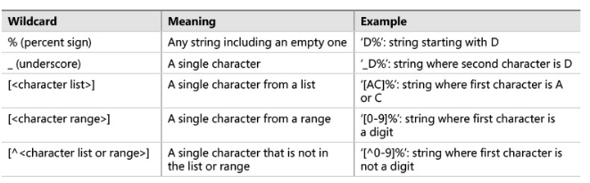

Slide 15
Restricting the Characters in Pattern Matches
SELECT <column1>,<column2>
FROM <schema>.<table>
WERE <column> LIKE 'value[a-c]';
SELECT <column1>,<column2>
FROM <schema>.<table>
WERE <column> LIKE 'value[a,b,c]';
SELECT <column1>,<column2>
FROM <schema>.<table>
WERE <column> LIKE 'value[^d]';

Slide 16
COMBINING WILDCARDS
SELECT LastName
FROM Person.Person
WHERE LastName LIKE 'Ber[r,g]%';
SELECT LastName
FROM Person.Person
WHERE LastName LIKE 'Ber[^r]%';
SELECT LastName
FROM Person.Person
WHERE LastName LIKE 'Be%n_';

Slide 17
1. Write a query that displays the product ID and name for each product from the
Production.Product table with a name starting with Chain.
2. Write a query like the one in question 1 that displays the products with Paint in the name.
3. Change the last query so that the products without Paint in the name are displayed.

Slide 18
Using WHERE Clauses with Three or More Predicates
A WHERE clause can contain more than two predicates combined by the logical operators AND and OR. If a WHERE clause contains more than two predicates using both AND and OR, you must be careful to ensure that the query returns the expected results.
NOT, AND, OR

Slide 19
Using NOT with Parentheses
Another interesting twist when using parentheses is that you can negate the meaning of the expression within them by specifying the keyword NOT.

Slide 20
USING IN OPERATOR
SELECT <column1>,<column2>
FROM <schema>.<table>
WHERE <column> IN (<value1>,<value2>);
You will probably find that the operator IN can simplify many queries, but it can be very slow

Slide 21
WORKING WITH NOTHING
NULL
WHAT IS NULL
Is null
Is not null

Slide 22
Excercise
1. Write a query displaying the ProductID, Name, and Color columns from rows in the Production.Product table. Display only those rows where no color has been assigned.
2. Write a query displaying the ProductID, Name, and Color columns from rows in the Production.Product table. Display only those rows in which the color is known not to be blue.
3. Write a query displaying ProductID, Name, Style, Size, and Color from the
Production.Product table. Include only the rows where at least one of the Style, Size, or
Color columns contains a value.

Slide 23
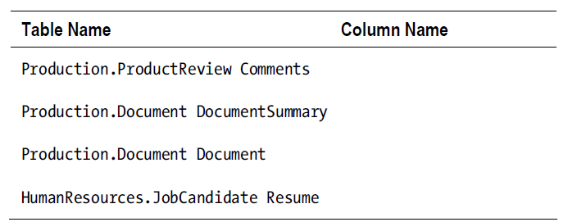
Performing a Full-Text Search
Full-text search provides the ability to search for words or phrases within string or binary data columns similar to a web search such as Google or Bing.

Slide 24
Using CONTAINS
SELECT <column1>,<column2>
FROM <schema>.<tablename>
WHERE CONTAINS(<indexed column>,<searchterm>);

Slide 25
Using FREETEXT
FREETEXT is similar to CONTAINS except that it returns rows that don’t exactly match.
It will return rows that have terms with similar meanings to your search terms by using a thesaurus

Slide 26
ORDER BY
SELECT <column1>,<column2>
FROM <schema>.<tablename>
ORDER BY <column1>[<sort direction>],<column2> [<sort direction>]
ORDER BY OFFSET (skips rows)
ORDER BY FETCH NEXT…ONLY (HOW MANY ROWS TO RETURN)

Slide 27
EXCERCISE
1. Write a query that returns the business entity ID and name columns from the Person.Person table. Sort the results by LastName, FirstName, and MiddleName.
2. Modify the query written in question 1 so that the data is returned in the opposite order.
3. Modify the query written in question 1 so that you return only 10 rows starting at row 20.

